Slide 2
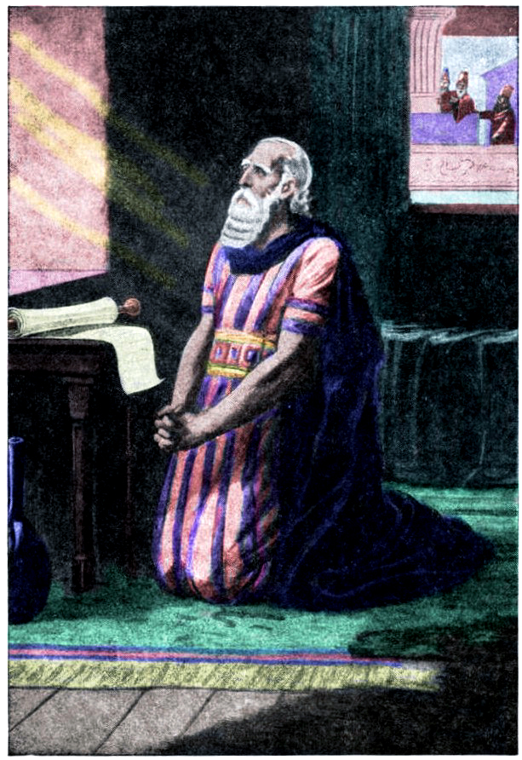
Daniel 9
Daniel’s Prayer

Slide 3
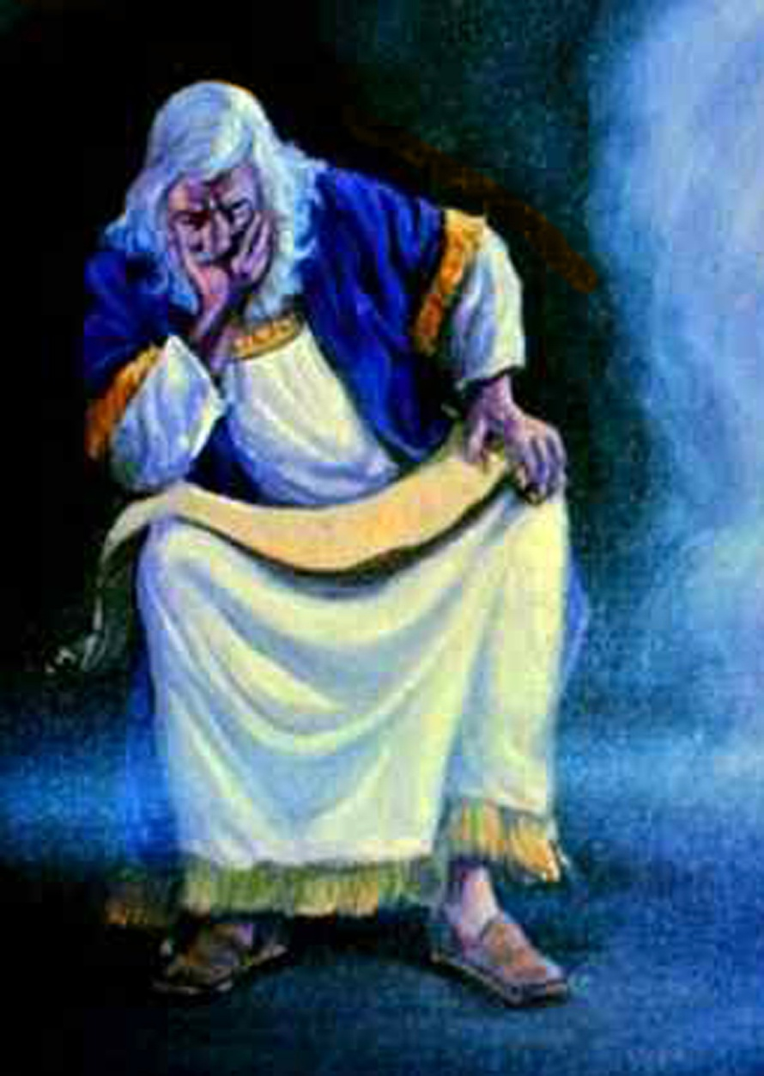
“In the first year of Darius the son of Ahasuerus, of the seed of the Medes, which was made king over the realm of the Chaldeans; In the first year of his reign I Daniel understood by books the number of the years, whereof the word of the LORD came to Jeremiah the prophet, that he would accomplish seventy years in the desolations of Jerusalem.” Daniel 9:1,2
Daniel was not only a man of prayer, he was also a man who studied very carefully the scriptures, both the books of Moses and the writings of the prophets.

Slide 4
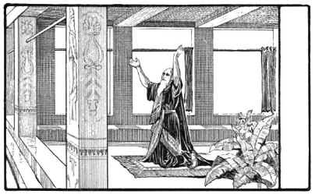
3. “And I set my face unto the Lord God, to seek by prayer and supplications, with fasting, and sackcloth, and ashes:”
When he learned from the writings of the prophet Jeremiah that Israel was to be in captivity for 70 years and the promise that it would then come back to the land and be a nation again, he did not just think, "Ok, Fine, That's nice. I'll just wait until it happens."

Slide 5
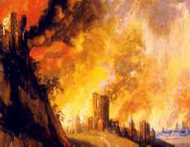
Oh, no! He set himself to pray, to plead with God that indeed the promises would be fulfilled. He claimed the promises!
4. “And I prayed unto the LORD my God, and made my confession, and said, O Lord, the great and dreadful God, keeping the covenant and mercy to them that love him, and to them that keep his commandments;
5. We have sinned, and have committed iniquity, and have done wickedly, and have rebelled, even by departing from thy precepts and from thy judgments:”

Slide 6
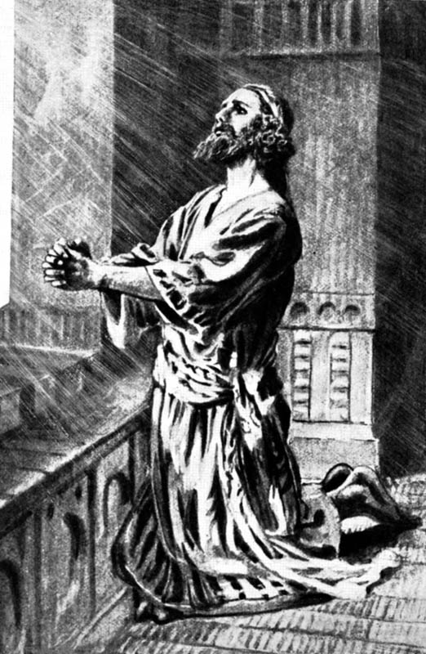
Now here is a very interesting thing; Daniel is one of the few people in the Bible that we have no record of any sin that he committed, and even his enemies had not been able to get anything bad they could charge him with.
He was called 'greatly beloved' by an angel, and yet he is here seen repenting in sackcloth and ashes and confessing his sins and the sins of Israel as it he were as guilty of them as the worst law-breaker among them.
Truly godly people are ever humble of heart and never boast of their great goodness or sinlessness.

Slide 7
6. “Neither have we hearkened unto thy servants the prophets, which spake in thy name to our kings, our princes, and our fathers, and to all the people of the land.”
Daniel well knew that it was because Israel had turned from her obedience to the Laws of God, and followed the ways of the heathen, that God had allowed her to be conquered and taken into captivity. He clearly states that this was what the sins of Israel had brought upon her. God had sent many prophets with warning messages, but they had been ignored and persecuted. Reproof is never popular in any age.

Slide 8
7. “O Lord, righteousness belongeth unto thee, but unto us confusion of faces, as at this day; to the men of Judah, and to the inhabitants of Jerusalem, and unto all Israel, that are near, and that are far off, through all the countries whither thou hast driven them, because of their trespass that they have trespassed against thee.”
Daniel does not proclaim his own fidelity before the Lord. Instead of claiming to be pure and holy, this honored prophet humbly identifies himself with the really sinful of Israel. The wisdom which God had imparted to him was as far superior to the wisdom of the great men of the world as the light of the sun shining in the heavens at noonday is brighter than the feeblest star.

Slide 9
Yet ponder the prayer from the lips of this man so highly favored of Heaven. With deep humiliation, with tears and rending of heart, he pleads for himself and for his people. He lays his soul open before God, confessing his own unworthiness and acknowledging the Lord's greatness and majesty.
8. “O Lord, to us belongeth confusion of face, to our kings, to our princes, and to our fathers, because we have sinned against thee.”

Slide 10
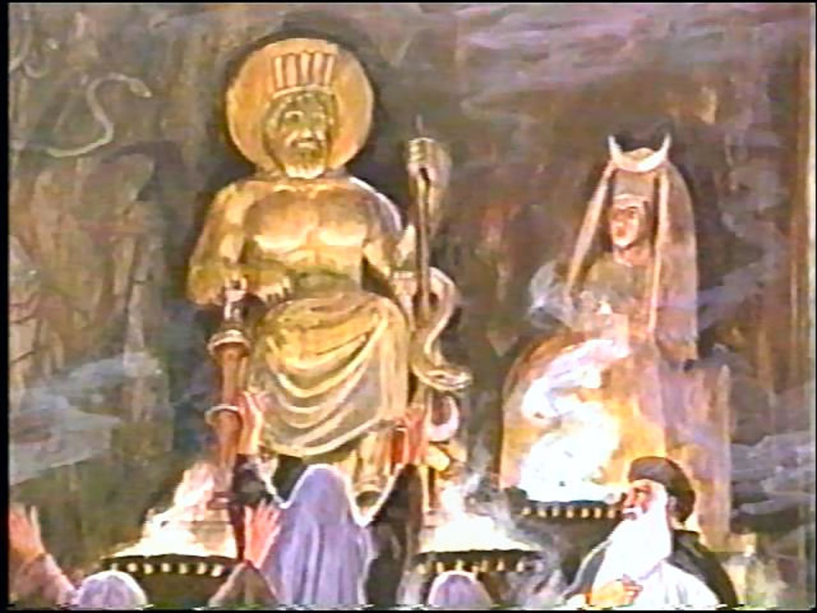
9. “To the Lord our God belong mercies and forgivenesses, though we have rebelled against him; 10. Neither have we obeyed the voice of the LORD our God, to walk in his laws, which he set before us by his servants the prophets. 11. Yea, all Israel have transgressed thy law, even by departing, that they might not obey thy voice; therefore the curse is poured upon us, and the oath that is written in the law of Moses the servant of God, because we have sinned against him.”

Slide 11
In Deuteronomy 28 Moses, just before he died, warned Israel clearly that if they obeyed God and walked in His ways, they would be blessed - but if they did not and went the ways of the heathen, they would be cursed. And yet they had gone into idolatry and all sorts of wickedness.
12 And he hath confirmed his words, which he spake against us, and against our judges that judged us, by bringing upon us a great evil: for under the whole heaven hath not been done as hath been done upon Jerusalem.

Slide 12
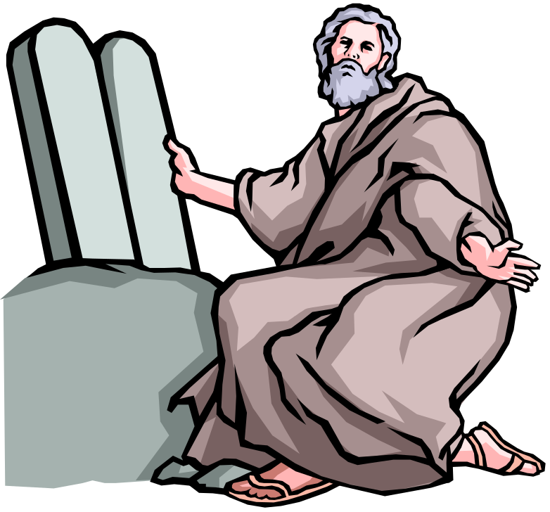
Now Daniel declares that the very words written in the Books of Moses had verily been fulfilled and justly so.
13. “As it is written in the law of Moses, all this evil is come upon us: yet made we not our prayer before the LORD our God, that we might turn from our iniquities, and understand thy truth. 14. Therefore hath the LORD watched upon the evil, and brought it upon us: for the LORD our God is righteous in all his works which he doeth: for we obeyed not his voice.”

Slide 13
15. “And now, O Lord our God, that hast brought thy people forth out of the land of Egypt with a mighty hand, and hast gotten thee renown, as at this day; we have sinned, we have done wickedly.
16. O Lord, according to all thy righteousness, I beseech thee, let thine anger and thy fury be turned away from thy city Jerusalem, thy holy mountain: because for our sins, and for the iniquities of our fathers, Jerusalem and thy people are become a reproach to all that are about us.”

Slide 14
17 “Now therefore, O our God, hear the prayer of thy servant, and his supplications, and cause thy face to shine upon thy sanctuary that is desolate, for the Lord's sake. 18 O my God, incline thine ear, and hear; open thine eyes, and behold our desolations, and the city which is called by thy name: for we do not present our supplications before thee for our righteousnesses, but for thy great mercies. 19. O Lord, hear; O Lord, forgive; O Lord, hearken and do; defer not, for thine own sake, O my God: for thy city and thy people are called by thy name.”

Slide 15
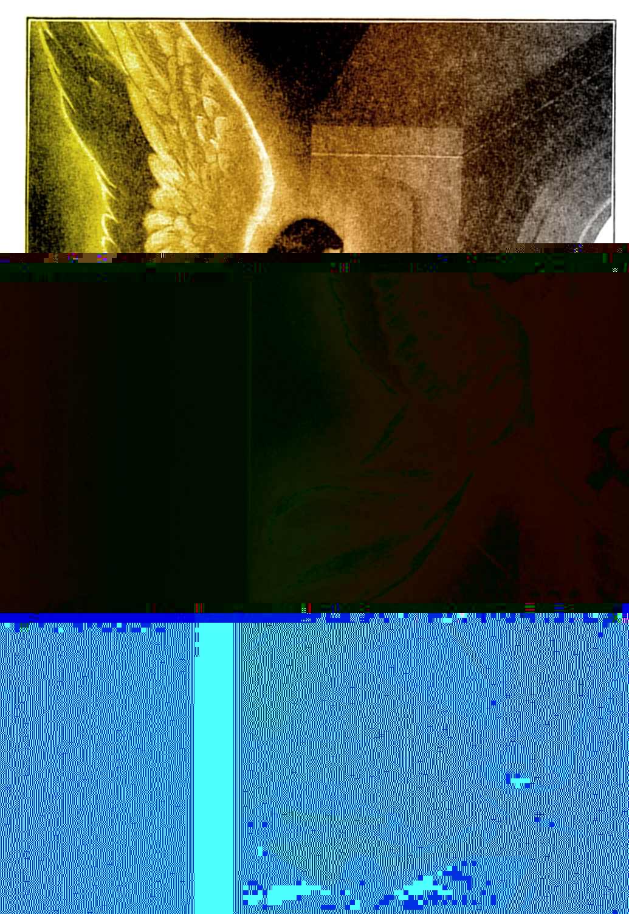
20. “And whiles I was speaking, and praying, and confessing my sin and the sin of my people Israel, and presenting my supplication before the LORD my God for the holy mountain of my God; 21. Yea, whiles I was speaking in prayer, even the man Gabriel, whom I had seen in the vision at the beginning, being caused to fly swiftly, touched me about the time of the evening oblation.”

Slide 16
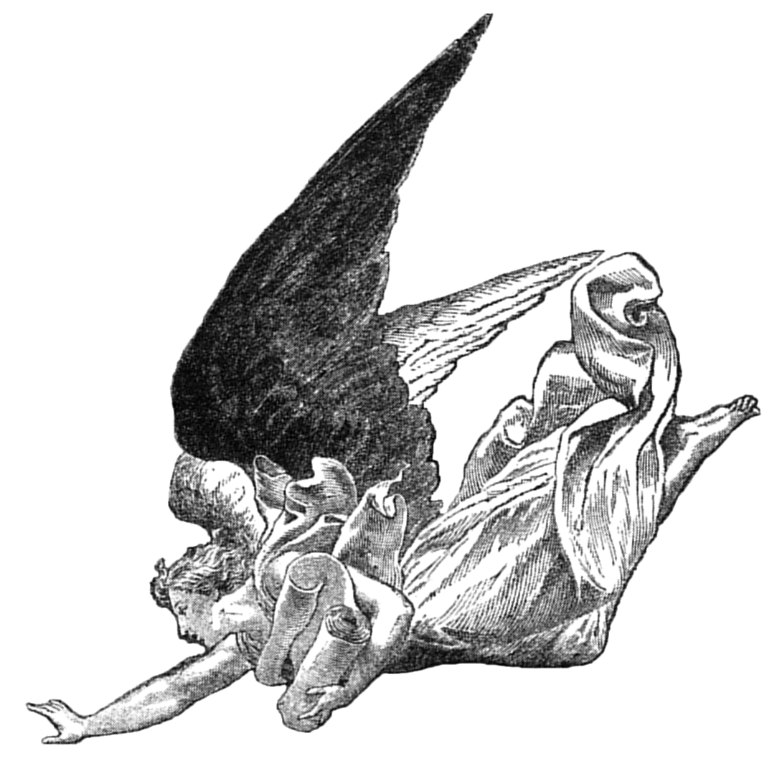
As Daniel's prayer is going forth, the angel Gabriel comes sweeping down from the heavenly courts to tell him that his petitions are heard and answered. This mighty angel has been commissioned to give him skill and understanding--to open before him the mysteries of future ages. Thus, while earnestly seeking to know and understand the truth, Daniel was brought into communion with Heaven's delegated messenger. Heaven is no further away today, then it was for Daniel!

Slide 17
22. “And he informed me, and talked with me, and said, O Daniel, I am now come forth to give thee skill and understanding.
23 At the beginning of thy supplications the commandment came forth, and I am come to shew thee; for thou art greatly beloved: therefore understand the matter, and consider the vision.”

Slide 18
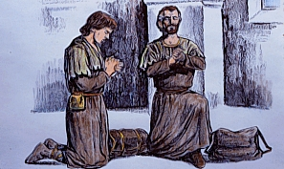
Have not we as great need to call upon God as had Daniel? I address those who believe that we are living in the very last period of this earth's history. I entreat you to take upon your own souls a burden for our churches, our schools, and our institutions. That God who heard Daniel's prayer will hear ours when we come to Him in contrition. Our necessities are as urgent, our difficulties are as great, and we need to have the same intensity of purpose, and in faith roll our burden upon the great Burden-bearer. There is need for hearts to be as deeply moved in our time as in the time when Daniel prayed.

Slide 19
Chapter 9 continues in
‘THE AMAZING TIME PROPHECY!’ of Daniel 8 & 9

